Slide 1

Designing automation framework with Selenium

Slide 2




What are we going to learn today ?
At the end of the session you will be able to understand :
What is Automation Testing
Selenium Suite
Selenium IDE
Selenium RC
Selenium WebDriver
Selenium Grid
How to design a Test Framework
Keyword Driven
Data Driven
Demo on designing a Selenium Test Framework

Slide 3

Manual Testing
It’s boring and tedious !!
I have to do the same process again and again with multiple sets of data. There is no change in the application as well

Slide 4
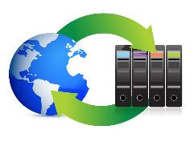




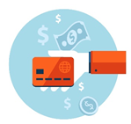
Automation Testing
Automated execution through test scripts
Auto-generation of result file
Taking Screenshot and Auto-generation of report

Slide 5

Automation Testing (Contd.)
Amazing !!
Now I don’t have to do the same process again and again with different sets of data. Everything is handled by the tool itself. Even execution flow is too fast.
Thanks to Automation Testing

Slide 6
Automation Testing Advantages
Cost Reduction
Reusability
Fast
Unattended Execution
Reliability
Better Quality

Slide 7
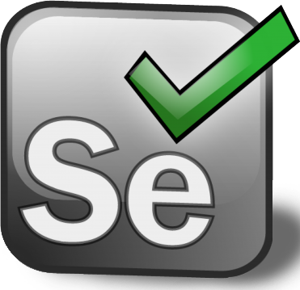
What is Selenium?
Selenium is a suite of tools to automate web browsers across many platforms
Selenium features
Support for different programming languages - Java, Python, PHP, Ruby, Perl, JavaScript
Support for different Operating Systems - Windows, Mac, Linux, iOS, Android
Support for different browsers – IE, Firefox, Chrome, Safari, Opera

Slide 8






Who uses Selenium?

Slide 9
Understanding Selenium Suite
Who uses Selenium?

Slide 10
Selenium Suite
Selenium Suite
Selenium IDE
Selenium RC
WebDriver
Selenium Grid
Merged
Selenium 2

Slide 11
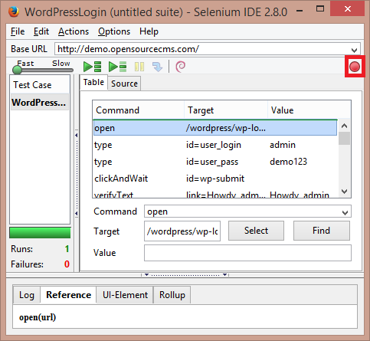
Selenium Suite – Selenium IDE
Selenium IDE is a Firefox plugin which records and plays back user interactions with the browser
Using Selenium IDE you can export the programming code in different languages like Java, Ruby, Python etc.
It allows to record and play back tests conveniently that were recorded previously in Selenium IDE
Selenium IDE is not the best solution for production testing

Slide 12
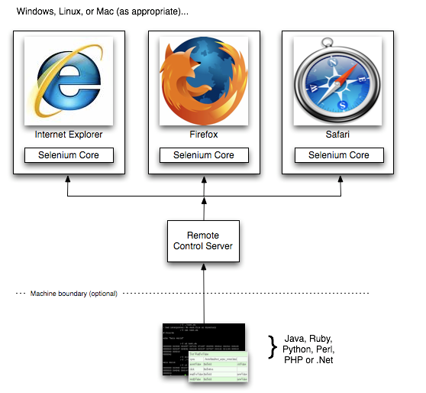
Selenium Suite – Selenium RC
Selenium Remote Control (RC) is a test tool that allows you to write web application tests in any programming language
RC Server receives the Selenium commands called Selenese from test program using simple HTTP GET/POST requests
Selenium RC Architecture

Slide 13
Selenium Suite – Web Driver
Selenium WebDriver is a compact Object Oriented API when compared to Selenium 1.0
It interacts with browser directly while Selenium RC needs help of RC Server to interact with browser which makes it slow
Selenium WebDriver overcomes the limitations of Selenium 1, like file upload or download, pop-ups and dialogs barrier

Slide 14


Selenium Suite – Selenium Grid
Selenium-Grid runs multiple tests at the same time against different machines running different browsers and operating systems
Node 1: IE on Windows
Node 2: Android
Node 3: Safari on Mac
Node 4: Firefox in Ubuntu

Slide 15
Designing Selenium Test Framework
Selenium Suite – Selenium Grid
Selenium-Grid runs multiple tests at the same time against different machines running different browsers and operating systems
Node 1: IE on Windows
Node 2: Android
Node 3: Safari on Mac
Node 4: Firefox in Ubuntu

Slide 16
Selenium Test Framework
While testing a web application using Selenium its very important to design a flexible test framework that can easily be modified and reused
Selenium offers flexibility to create different types of test framework that can be reused
Keyword Driven
Framework runs on list of keywords
Hybrid Framework
Keyword Driven
+
Data Driven
Data Driven
Recursively tests application using large data pool

Slide 17
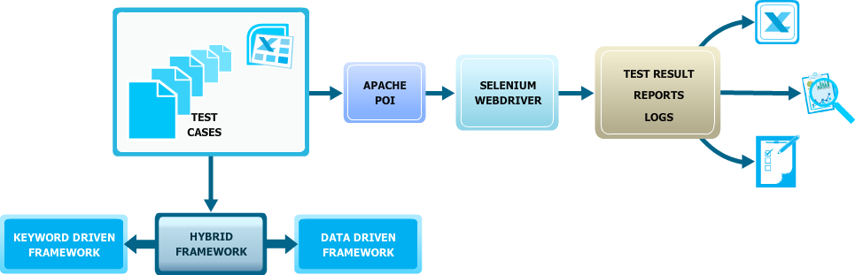

Types of Test Framework

Slide 18
Keyword Driven Framework
In this framework flow of the automation is dependent on keywords
Each keyword in keyword driven framework has a specific meaning like
Wait: Wait for some specific time
Verify: Validation of text, object, value, or more
Store: Store the value from web application
Scroll Down: Scroll down in application
Click, Enter Text, Select → They are actions

Slide 19
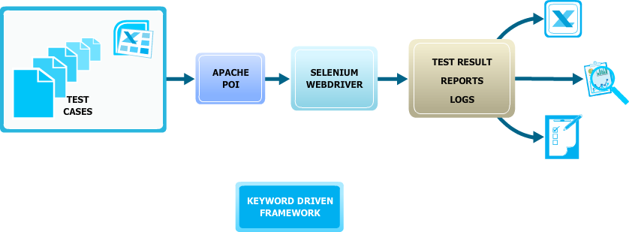
Keyword Driven Framework (Contd.)

Slide 20
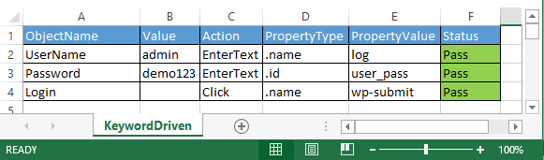
Keyword Driven Framework (Contd.)
The above snapshot is of test script for Keyword Driven Framework
Test Case to test framework will not change only data in excel will change with corresponding action
Object Name → Gives a picture what is there in that step
Value → If any value has to be entered then it has to be passed or else blank
Action → What action to be performed
Property Type → which identifier is used to find an object
Property Value → identifier value
Status → If action performed successfully then Pass or else Fail

Slide 21
Hands-On
Selenium Suite – Selenium Grid
Selenium-Grid runs multiple tests at the same time against different machines running different browsers and operating systems
Node 1: IE on Windows
Node 2: Android
Node 3: Safari on Mac
Node 4: Firefox in Ubuntu

Slide 22
Data Driven Framework
Data driven framework is almost same as keyword driven framework but in this framework we deal with variable data
Executing test case with different sets of data
Data driven framework is very helpful when we want to test the application with different sets of data and doing it manually is a difficult and error prone task

Slide 23
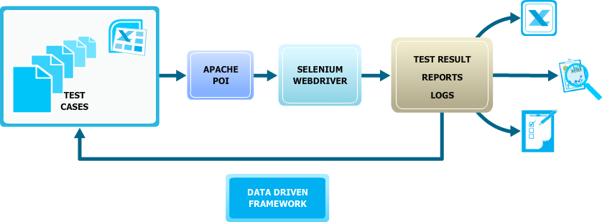
Data Driven Framework (Contd.)

Slide 24
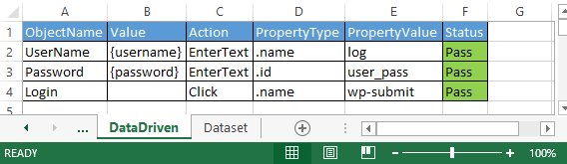
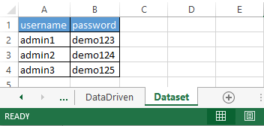
Data Driven Framework (Contd.)
In second column of DataDriven tab values are in curly braces({,}) which tells the tool that this field is dynamic and it’s value has to be fetched from dataset tab
Total Number of Execution = Number of Rows in dataset

Slide 25
Hands-On
Selenium Suite – Selenium Grid
Selenium-Grid runs multiple tests at the same time against different machines running different browsers and operating systems
Node 1: IE on Windows
Node 2: Android
Node 3: Safari on Mac
Node 4: Firefox in Ubuntu

Slide 26
Survey
Your feedback is important to us, be it a compliment, a suggestion or a complaint.
It helps us to make the course better! Please spare few minutes to take the survey after the webinar

Slide 27
Thank You …
Questions/Queries/Feedback
Recording and presentation will be made available to you within 24 hours

